Slide 1
Computer Graphics Camera Control
László Szécsi szecsi@iit.bme.hu
AIT

Slide 2
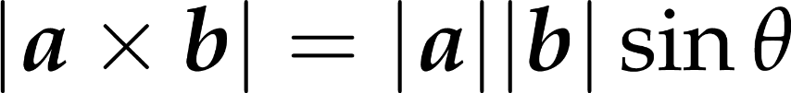


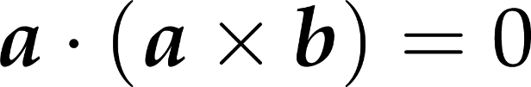
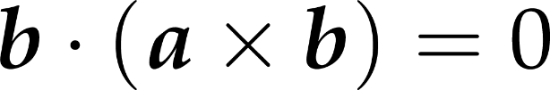


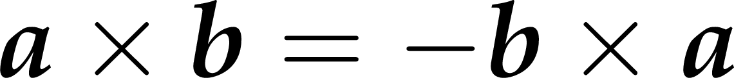
Cross product (vectorial product)
val a = Vec3(1.0f, 1.0f, 0.0f)
val b = Vec3(3.0f, 0.0f, 5.0f)
val axb = a.cross(b)
Notes:
Vectors can be multiplied with vectors in several ways. We talk about the vector product (a.k.a. cross product) now, as it is useful for setting up an orthogonal reference frame in 3D. Later, the dot product and the elementwise product will both be extremely useful. We will discuss those in due course.
The cross product of two 3D vectors is a vector of length equal to the product of the lengths of the two vectors and the sine of their angle. The resulting vector is perpendicular to both operands and points into the direction of the middle finger of our right hand if our thumb points into the direction of the first operand and our index finger into the direction of the second operand (right hand rule).

Slide 3
Cross product use cases
need a vector perpendicular to something
just cross with e.g. [0, 1, 0]
need vector perpendicular to two others
cross them
if operands are not normalized or not at a right angle to each other, then normalize result

Slide 4

The cross product is anticommutative
Notes:
The cross product is not commutative but anti-symmetric or alternating, which means that exchanging the two operands the result is multiplied by -1.

Slide 5
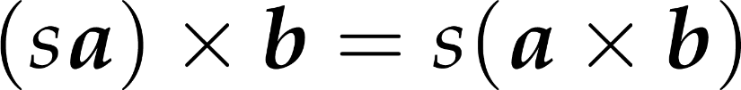
The cross product is homogeneous under scaling

Slide 6
The cross product is distributive over addition

Slide 7
First Person Camera
camera attached to avatar
not at the same position (would only see its inside), but moving with it
in effect it is like a game object that has the avatar as its parent
the camera’s view matrix is composed of the avatar’s model matrix and its local pose matrix computed with its relative orientation and position (and then inverted)
CAUTION! The position property of this camera is no longer the world space position, and should not be used in (lighting) shaders as such! You should introduce a differently named property that holds the world space camera position as is provided as a uniform.

Slide 8
Third Person Camera
yaw, pitch, roll unknown
but we know the look-at point
i.e. the avatar’s position
the world-space base vectors of the camera are found using the camera position and look-at point
the view matrix is assembled directly using these vectors

Slide 9
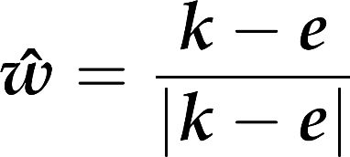
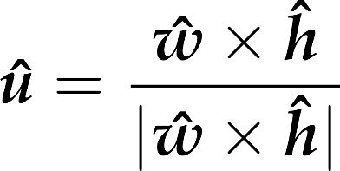







View transformation: base directions from lookat point
generic upwards
ahead
right
up
eye
y
lookat
z
x
Notes:
Vector w can be obtained from the main viewing direction (eye - lookat) by a simple normalization. The application of normalization to get v is also tempting, but simple normalization of h would not guarantee that basis vector v is orthogonal to basis vector w. So instead of directly computing v from h, first we obtain u as a vector that is orthogonal to both w and h. Then, v is computed indirectly through w and u to get it orthogonal to both of them.

Slide 10



View transformation: matrix from base directions and eye position
generic upwards
ahead
right
camera up
eye
y
z
x
Notes:
The view transformation in 3D is a translation and a rotation. This applies to ALL objects in the virtual world, camera included.
To goal is to place everything so that the camera's right aligns with the x axis and the camera's up aligns with the y axis. This is consistent with the normalized device space coordinates we had in 2D. If x points to the right ad y points up, where should z point to? Let us make an orthogonal frame using our thumb, index and middle fingers. If thumb points along x, index along y, then let the middle finger points along z. If we used our right hand, z is towards us (pointing out of the screen). If we used our left hand, z points away from us (into the screen). Both are viable conventions. OpenGL historically prefers the right-handed one. It comes with the benefit that a rotation with a positive angle around the positive z axis is counterclockwise in the xy plane, which is again the usual convention for rotations by positive angles.
We apply a transformation on the scene, including objects and the camera, that moves the camera to the origin and rotates it to make the ahead direction be axis –z and the camera’s vertical direction be axis y. To find such transformation, we assign an orthonormal basis to the camera so that its first basis vector, u, is the camera’s horizontal direction, the second, v, is the vertical direction, and the third, w, is the opposite of the ahead direction (we reverse the ahead direction to maintain the right handedness of the system).

Slide 11
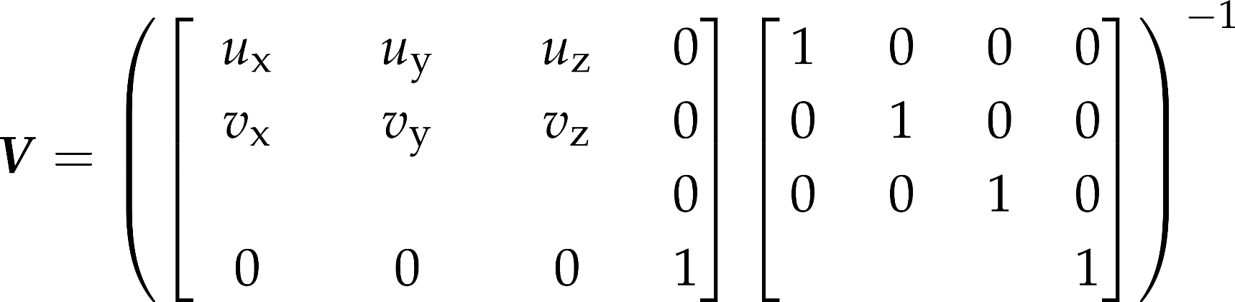
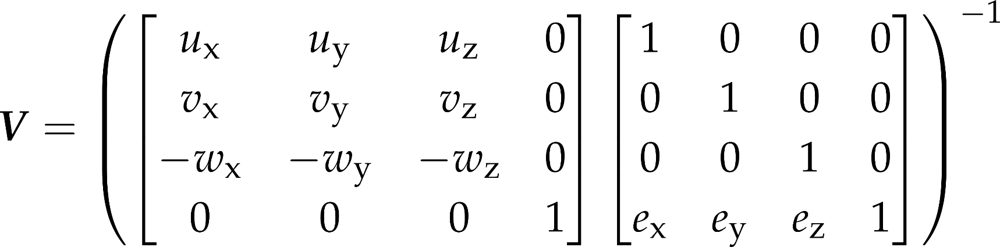
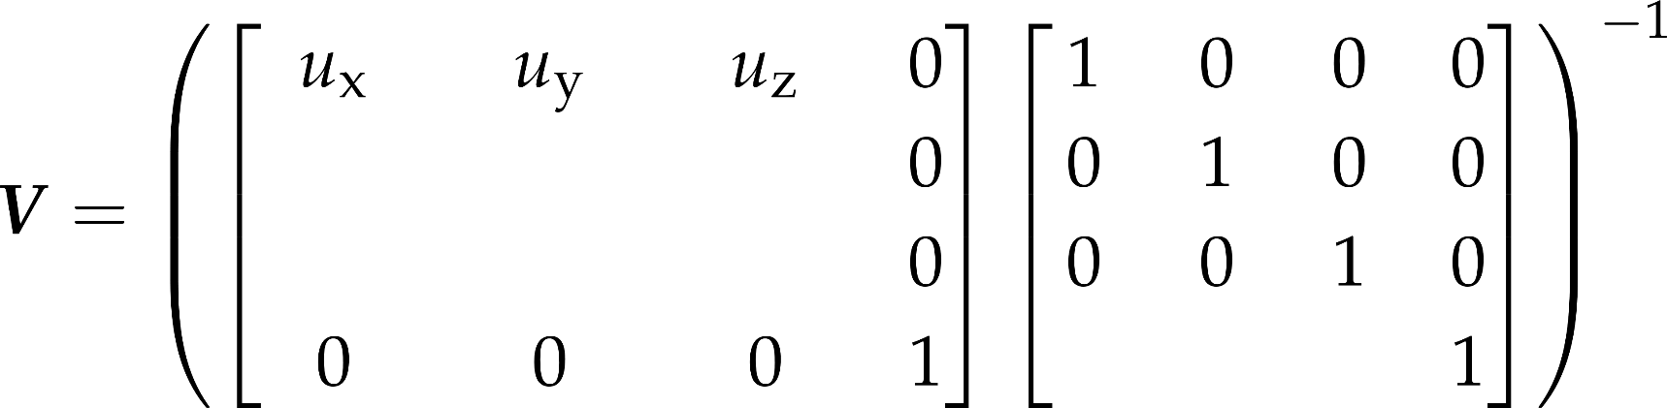
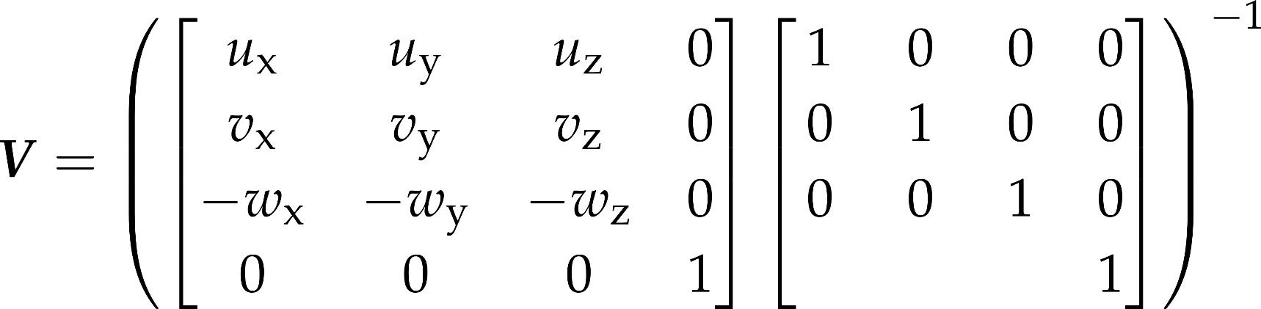
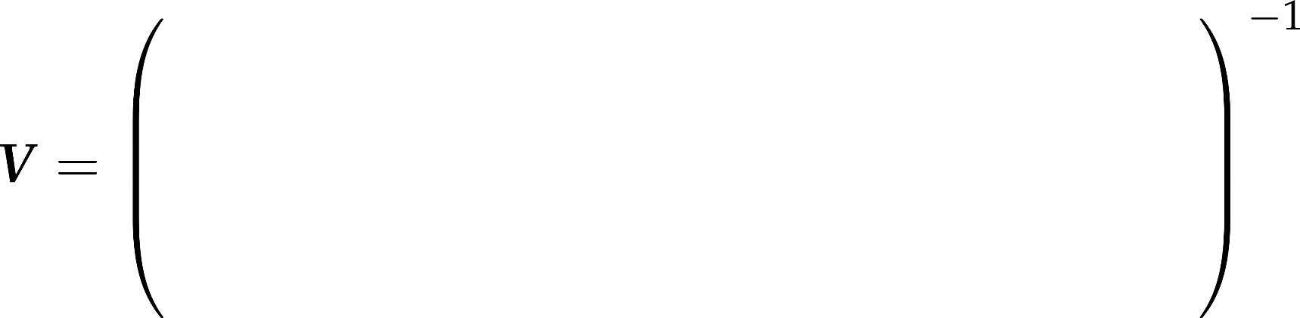
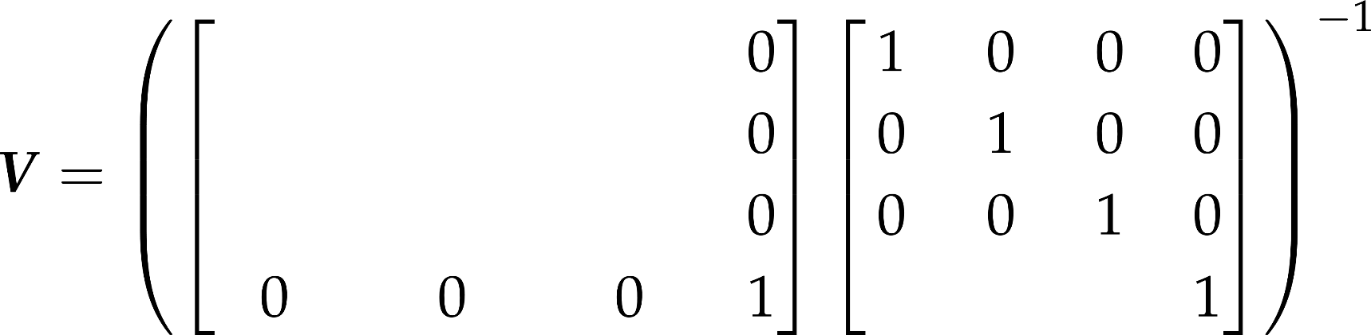

View transformation: matrix from base directions and eye position
generic upwards
ahead
right
camera up
eye
y
z
x
Notes:
The transformation we are looking for is a translation then a rotation. The translation moves the eye position to the origin. The translation has a simple homogeneous linear transformation matrix. Having applied this translation, the orientation should be changed to align vector w with axis z, vector v with axis y, and vector u with axis x. Although this transformation is non-trivial, its inverse that aligns axis x with u, axis y with v, and axis z with w is straightforward.
Its basic idea is that the rows of an affine transformation (fourth column is [0,0,0,1]^{T}) are the images of the three basis vectors and the origin respectively.
So, the transformation of x,y,z axes to u,v,w is the matrix that contains u,v,w as the row vectors of the 3x3 minor matrix of the 4x4 transformation matrix.
As we need the inverse transformation, this matrix needs to be inverted. Such matrices – called orthonormal matrices – are easy to invert, since their transpose is their inverse.

Slide 12
Generic up direction in the world
companion object {
val worldUp = Vec3(0.0f, 1.0f, 0.0f)
}

Slide 13
Base directions
right = ahead.cross( worldUp ).normalize()
up = right.cross( ahead)

Slide 14
Compute view matrix
viewMatrix.set(
right.x , right.y , right.z , 0,
up.x , up.y , up.z , 0,
-ahead.x , -ahead.y , -ahead.z , 0,
0 , 0 , 0 , 1).
translate(position).
invert()
viewProjMatrix.set(viewMatrix).mul(projMatrix)

